Slide 1
Artificial Intelligence in the Financial Industry
2025
Kylie Fan

Slide 2
CONTENTS
01
02
03
AI Applications in the Financial Industry
Financial Data Processing & Analysis
Financial Data Processing & Analysis
04
05
AI Modeling Basics for Finance
AI Modeling Basics for Finance

Slide 3
AI Modeling Basics for Finance
04
Introduction to ML for Finance

Slide 4



Understand core ML Problem types in Finance

Slide 5
Types of ML Problems in Finance
Regression: Predicting continuous values (e.g., next-day stock prices)
Classification: predicting discrete labels (e.g., loan default, credit approval)
Clustering: unsupervised grouping (e.g., customer segmentation)

Slide 6
Examples of Use Cases
Regression: e.g., AAPL price forecasting
Classification: e.g., loan approval prediction
Clustering: e.g., grouping retail investors by behavior

Slide 7
Supervised vs Unsupervised Learning

Slide 8
Supervised Learning
Learn from labeled data (X Y)
Goal: Predict output based on input
Examples:
Predict stock price (regression)
Predict loan default (classification)

Slide 9
Unsupervised Learning
No labels, discover hidden patterns in data
Goal: group or reduce data
Examples:
Segment costumes (clustering)
Reduce dimensions (PCA)

Slide 10

Google ML Tools Overview

Slide 11
Examples
Google Colab: Python notebooks in the cloud (free GPU access)
Vertex AI: end-to-end model deployment on Google Cloud
AutoML: GUI-driven model creation, tuning, and deployment

Slide 12

Data Preparation Tools
Pandas: dataframe operations
NumPy: array math for time-series data
Cleaning: fill missing, normalize, encode dates

Slide 13
Feature Engineering

Slide 14
What is Feature Engineering?
The process of creating new input feature from raw data to improve model performance.
Helps extract meaningful patterns and signals that predictive models can learn from.

Slide 15
Examples
Rolling averages: 7-day and 30-day moving averages to smooth noise
Lagged features: previous day’s close (close_t-1), return over last 3 days
Volatility: rolling standard deviation over N days
Momentum indicators: price difference between current and lagged values
Price ratios: high/low, close/open, volume/average volume

Slide 16

Hands-On Exercise
Goal: Predict next-day AAPL stock price

Slide 17
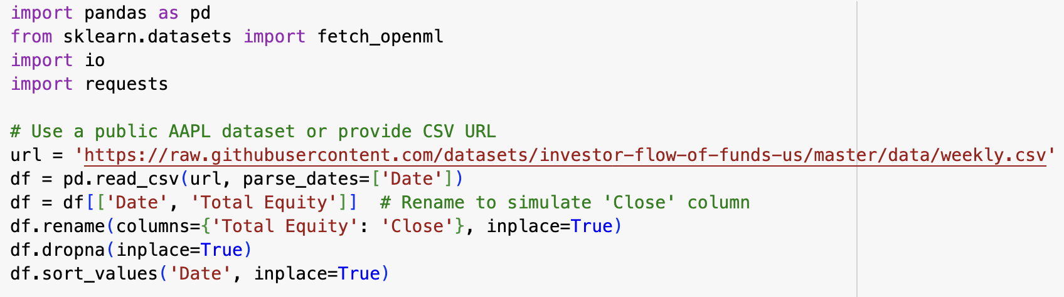
Step 1: Load data in Google Colab

Slide 18
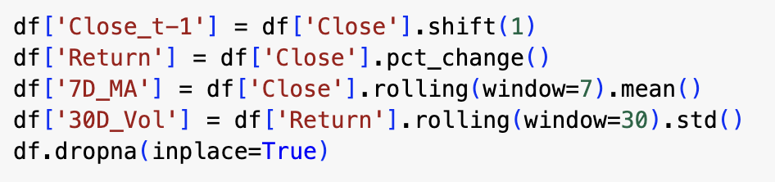
Step 2: Feature Engineering with Pandas

Slide 19
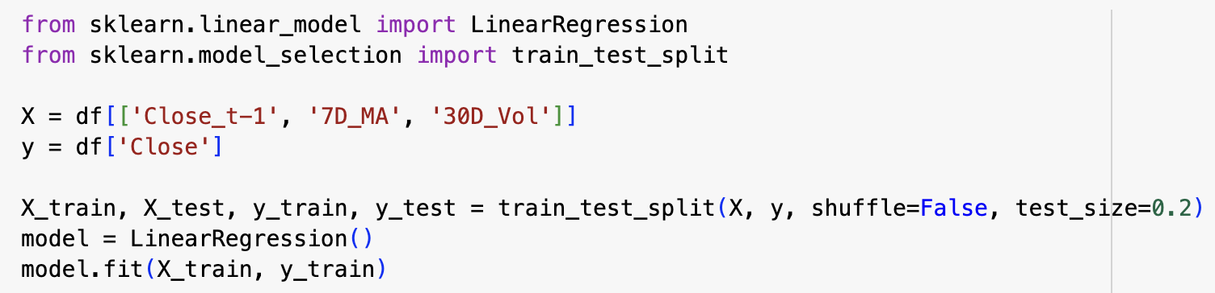
Step 3: Build & Train LinearRegression Model

Slide 20
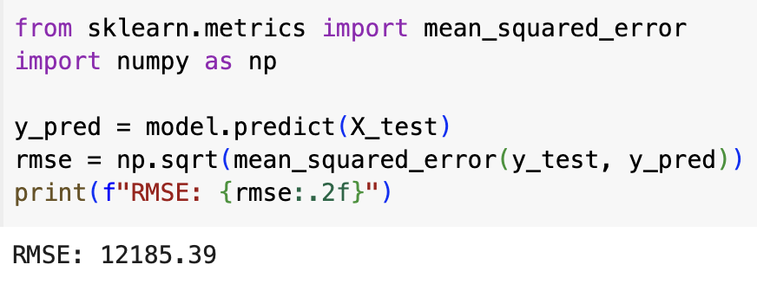
Step 4: Evaluate using RMSE

Slide 21
Step 5: Explain results
An RMSE (Root Mean Squared Error) of 12,185.39 indicates that the model's predicted stock prices deviate from actual values by an average of ~$12,185, which is clearly too large and unrealistic for AAPL (or any equity).
Why is RMSE so high?
Incorrect Data Source
Feature Engineering Misalignment:
Features like Close_t-1, 7D_MA, and 30D_Vol assume the data represents stock prices.
If the underlying data doesn't have daily price behavior, these features lose predictive value.

Slide 22
Step 6: How to fix or Improve
Normalize Features
Standardize or scale features to improve regression learning.
Evaluate Baseline Performance:
Use a naive model (e.g., predicting today's price is same as yesterday) and compare its RMSE.

Slide 23
THANKS FOR WATCHING
2025

